Slide 1



Easiest way to earn Pocket Money and
gain Experience

Slide 2



Current scenario?
Colleges have reopened and students
are at home due to COVID-19 situation.
Classes are taking place online, which
leaves some spare time with the students.

Slide 3



How can you utilize your time in the best way?
Part time - Work from home
internships
Campus Ambassador internships
Volunteering Activities

Slide 4




Why should you go for Part-time Internships?

Slide 5

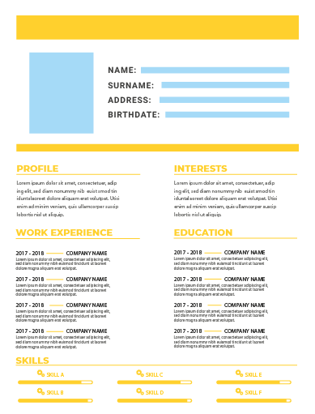


Work just 2-3 hours
a day
Value addition to the
resume

Slide 6


Earn Pocket Money
Improve Job prospects

Slide 7





Most preferred categories of Internships
Marketing
Research
Operations
Graphic Designing
Content Writing

Slide 8

How to get Part-time Internships?
Internshala, World’s No. 1 Internship Platform!
“Students can apply to part-time internships completely free of cost”

Slide 9

Did you know?
5 Lakh + students have got a
Part-time internship through Internshala
and earned up to ₹ 1,20,000 as Stipend

Slide 10



How does Internshala work?
Register for free and complete your profile
Explore internships from various Profiles
Apply & Get Hired
Go to - https://internshala.com/internships

Slide 11


A word from interns
Ujjwal Agarwal
Nithish Venkatesh
Earned stipend: INR 15,000
Bought DSLR camera
with his stipend
Earned stipend: INR 15,000
Bought gifts for his parents
with his stipend

Slide 12

Questions?

